Slide 1
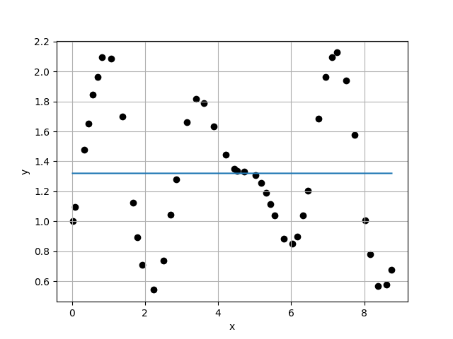
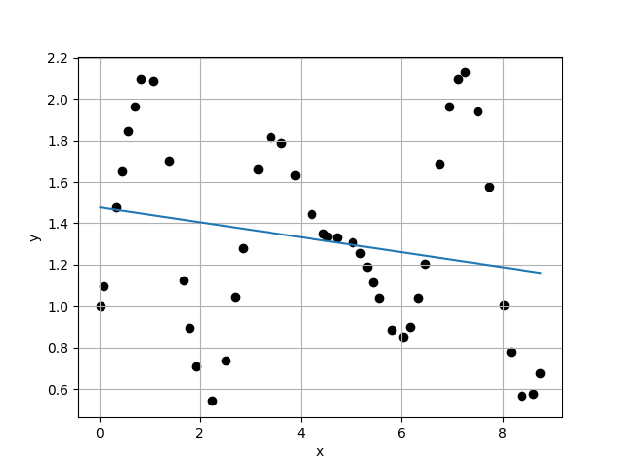
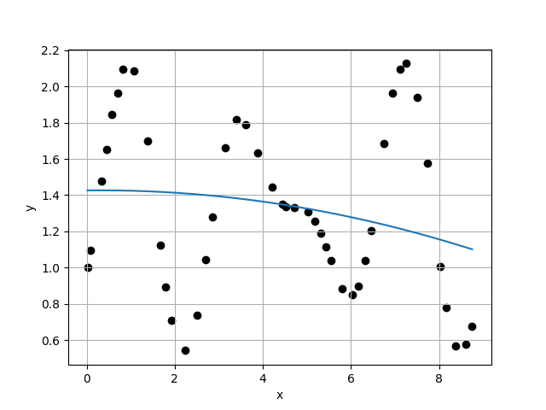
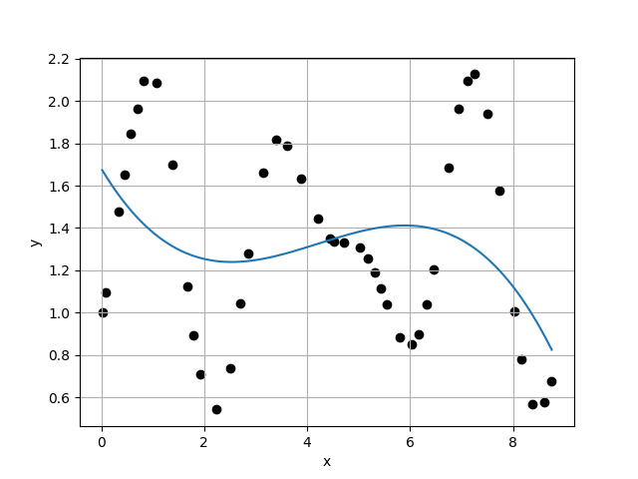
Case 1 :
Case 2 :
f(x) = 1.3200E+00
f(x) = 1.4772E+00 + -3.6178E-02 * x
4.6732E-01
4.6243E-01
1.0106E+00
9.9023E-01
Case 3 :
f(x) = 1.4260E+00 + 2.8636E-03 * x + -4.5716E-03 * x^2
Case 4 :
f(x) = 1.6814E+00 + -4.0739E-01 * x + 1.1501E-01 * x^2 + -9.1013E-03 * x^3
4.6699E-01
4.5387E-01
1.0289E+00
1.0526E+00

Slide 2
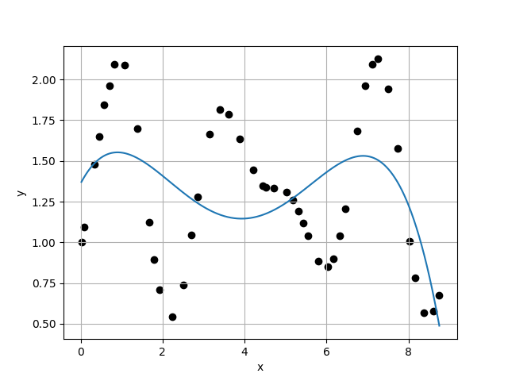
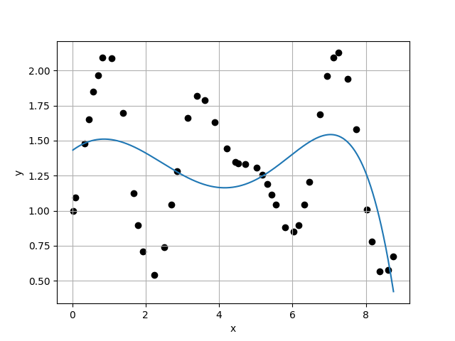
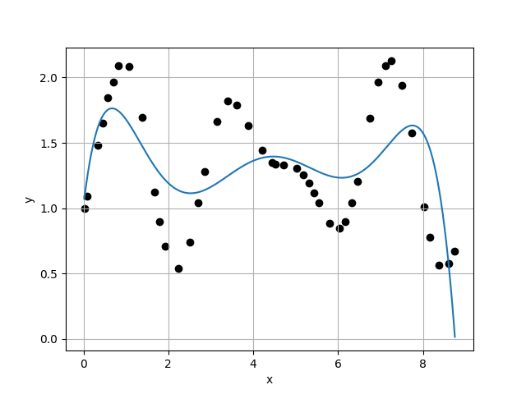
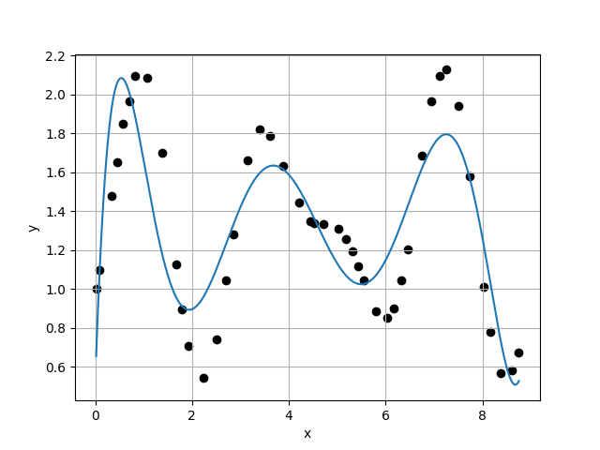
Case 5 :
Case 6 :
f(x) = 1.3611E+00 + 4.8095E-01 * x + -3.6301E-01 * x^2 + 7.7062E-02 * x^3 + -4.9326E-03 * x^4
f(x) = 1.4285E+00 + 1.9678E-01 * x + -1.2338E-01 * x^2 + 2.8552E-03 * x^3 + 4.6400E-03 * x^4 + -4.3659E-04 * x^5
4.3121E-01
4.3553E-01
9.9007E-01
1.1226E+00
Case 7 :
f(x) = 1.0190E+00 + 2.7100E+00 * x + -3.2470E+00 * x^2 + 1.4870E+00 * x^3 + -3.1961E-01 * x^4 + 3.2487E-02 * x^5 + -1.2590E-03 * x^6
Case 8 :
f(x) = 5.1413E-01 + 7.2331E+00 * x + -1.1132E+01 * x^2 + 6.7832E+00 * x^3 + -2.0319E+00 * x^4 + 3.1839E-01 * x^5 + -2.5021E-02 * x^6 + 7.7774E-04 * x^7
3.8798E-01
2.6512E-01
1.4634E+00
1.4120E+00

Slide 3
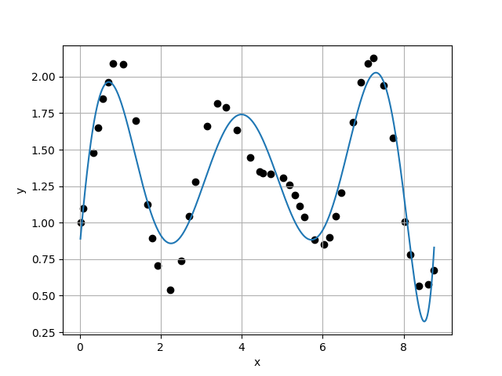
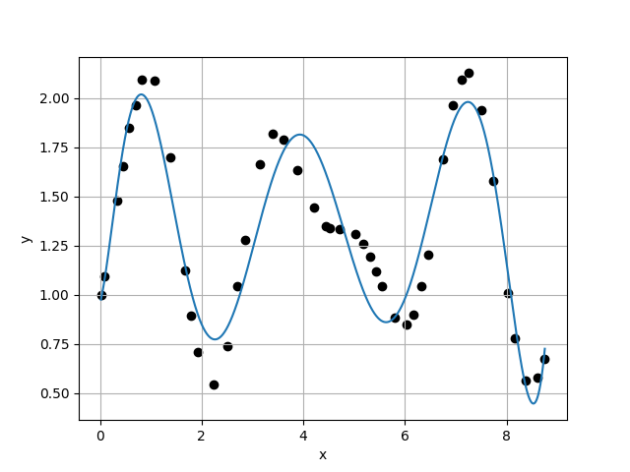
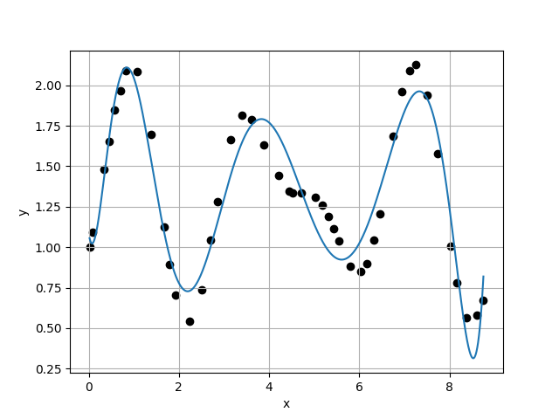
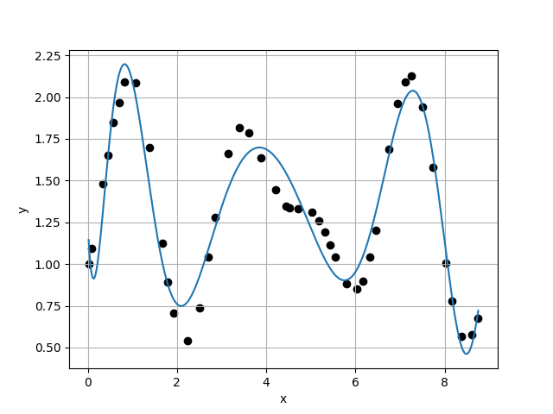
Case 9 :
Case 10 :
f(x) = 8.2613E-01 + 3.2037E+00 * x + -1.8051E+00 * x^2 + -1.5566E+00 * x^3 + 1.6610E+00 * x^4 + -5.7466E-01 * x^5 + 9.5088E-02 * x^6 + -7.6567E-03 * x^7 + 2.4107E-04 * x^8
f(x) = 9.5304E-01 + 1.0175E+00 * x + 4.4821E+00 * x^2 + -8.6330E+00 * x^3 + 5.7024E+00 * x^4 + -1.8830E+00 * x^5 + 3.4550E-01 * x^6 + -3.5716E-02 * x^7 + 1.9422E-03 * x^8 + -4.3076E-05 * x^9
1.8776E-01
1.7596E-01
1.0671E+00
1.0695E+00
Case 11 :
f(x) = 1.0858E+00 + -1.7702E+00 * x + 1.4025E+01 * x^2 + -2.1718E+01 * x^3 + 1.5014E+01 * x^4 + -5.7427E+00 * x^5 + 1.3287E+00 * x^6 + -1.9172E-01 * x^7 + 1.6969E-02 * x^8 + -8.4711E-04 * x^9 + 1.8328E-05 * x^10
Case 12 :
f(x) = 1.2479E+00 + -5.7628E+00 * x + 3.0197E+01 * x^2 + -4.8526E+01 * x^3 + 3.8422E+01 * x^4 + -1.7853E+01 * x^5 + 5.2719E+00 * x^6 + -1.0216E+00 * x^7 + 1.2967E-01 * x^8 + -1.0380E-02 * x^9 + 4.7514E-04 * x^10 + -9.4693E-06 * x^11
1.6453E-01
1.4735E-01
1.1166E+00
1.3013E+00

Slide 4
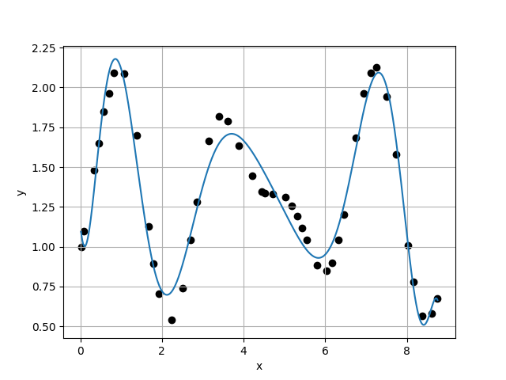
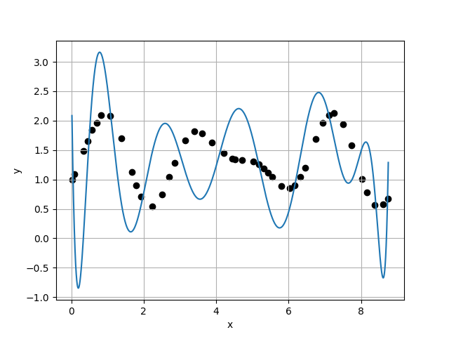
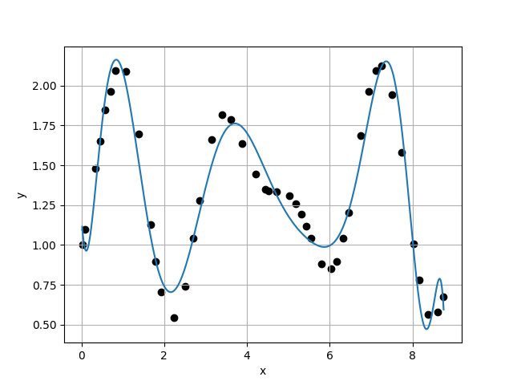
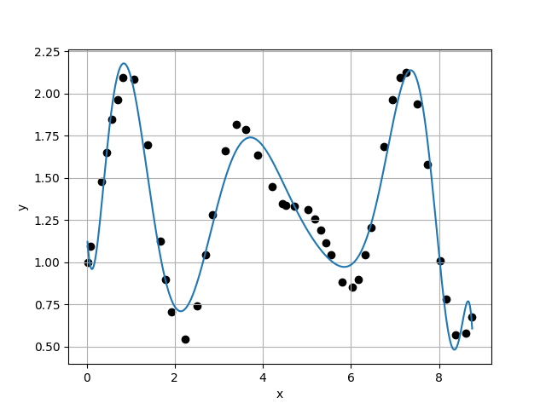
Case 13 :
Case 14 :
f(x) = 1.1439E+00 + -2.8204E+00 * x + 1.6112E+01 * x^2 + -2.0557E+01 * x^3 + 8.9268E+00 * x^4 + 7.7599E-01 * x^5 + -2.2544E+00 * x^6 + 9.9205E-01 * x^7 + -2.3123E-01 * x^8 + 3.2470E-02 * x^9 + -2.7586E-03 * x^10 + 1.3096E-04 * x^11 + -2.6715E-06 * x^12
f(x) = 2.9550E+00 + -4.7223E+01 * x + 1.9227E+02 * x^2 + -2.9697E+02 * x^3 + 2.2073E+02 * x^4 + -7.8290E+01 * x^5 + 4.1742E+00 * x^6 + 7.6684E+00 * x^7 + -3.4137E+00 * x^8 + 7.4949E-01 * x^9 + -9.8323E-02 * x^10 + 7.8159E-03 * x^11 + -3.4852E-04 * x^12 + 6.7081E-06 * x^13
1.1324E-01
8.9219E-01
1.2692E-01
6.6053E+00
Case 15 :
f(x) = 1.1915E+00 + -4.3549E+00 * x + 2.5018E+01 * x^2 + -4.2076E+01 * x^3 + 3.6416E+01 * x^4 + -2.0113E+01 * x^5 + 7.8157E+00 * x^6 + -2.1848E+00 * x^7 + 4.2588E-01 * x^8 + -5.3099E-02 * x^9 + 3.2137E-03 * x^10 + 1.0129E-04 * x^11 + -3.3074E-05 * x^12 + 2.2509E-06 * x^13 + -5.4716E-08 * x^14
Case 16 :
f(x) = 1.1993E+00 + -4.4289E+00 * x + 2.4390E+01 * x^2 + -3.8563E+01 * x^3 + 2.9917E+01 * x^4 + -1.3885E+01 * x^5 + 4.2362E+00 * x^6 + -8.6642E-01 * x^7 + 1.0676E-01 * x^8 + -2.9895E-03 * x^9 + -1.4743E-03 * x^10 + 2.6741E-04 * x^11 + -1.8395E-05 * x^12 + 1.1367E-07 * x^13 + 5.0999E-08 * x^14 + -1.9737E-09 * x^15
1.3507E-01
1.3624E-01
9.9143E-01
1.2006E+00

Slide 5
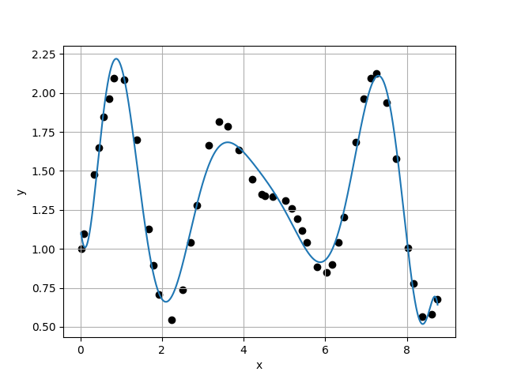
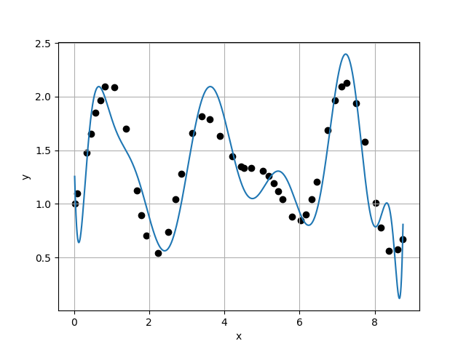
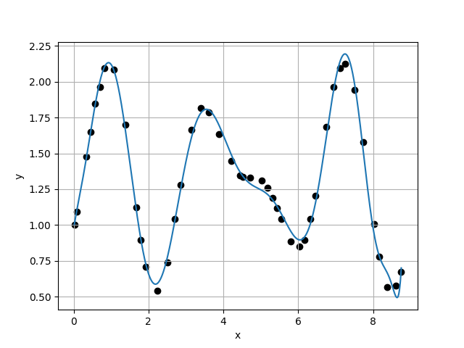
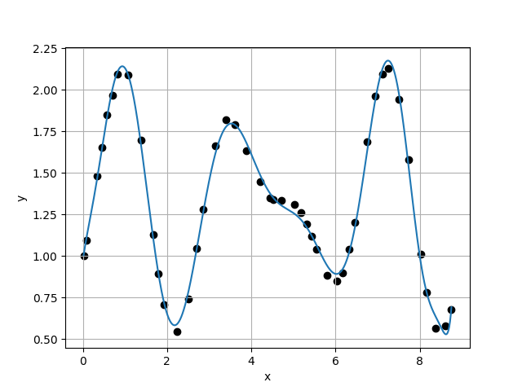
Case 17 :
Case 18 :
f(x) = 1.1507E+00 + -2.5800E+00 * x + 1.3120E+01 * x^2 + -1.1683E+01 * x^3 + -2.4873E+00 * x^4 + 8.3826E+00 * x^5 + -4.8962E+00 * x^6 + 1.2948E+00 * x^7 + -1.1216E-01 * x^8 + -2.6698E-02 * x^9 + 8.9034E-03 * x^10 + -9.5171E-04 * x^11 + -1.9489E-06 * x^12 + 1.1176E-05 * x^13 + -1.2227E-06 * x^14 + 5.8961E-08 * x^15 + -1.1311E-09 * x^16
f(x) = 1.5568E+00 + -1.7003E+01 * x + 1.0320E+02 * x^2 + -2.4048E+02 * x^3 + 3.0030E+02 * x^4 + -2.2763E+02 * x^5 + 1.1066E+02 * x^6 + -3.5198E+01 * x^7 + 7.2338E+00 * x^8 + -8.9182E-01 * x^9 + 4.6054E-02 * x^10 + 3.6542E-03 * x^11 + -9.3946E-04 * x^12 + 1.1646E-04 * x^13 + -1.3153E-05 * x^14 + 1.1743E-06 * x^15 + -6.1611E-08 * x^16 + 1.3584E-09 * x^17
1.1347E-01
2.7911E-01
4.0655E-01
5.0738E+00
Case 19 :
f(x) = 9.7055E-01 + 1.7378E+00 * x + -3.1933E+00 * x^2 + 1.1696E+01 * x^3 + -1.7404E+01 * x^4 + 1.1619E+01 * x^5 + -3.8903E+00 * x^6 + 5.9932E-01 * x^7 + -6.6405E-03 * x^8 + -9.0267E-03 * x^9 + 4.3736E-04 * x^10 + 1.1965E-04 * x^11 + -1.3066E-05 * x^12 + 1.1409E-06 * x^13 + -2.5799E-07 * x^14 + 1.4442E-08 * x^15 + 2.6265E-09 * x^16 + -3.4320E-10 * x^17 + 1.1322E-11 * x^18
Case 20 :
f(x) = 9.6785E-01 + 1.8723E+00 * x + -4.0521E+00 * x^2 + 1.3606E+01 * x^3 + -1.9275E+01 * x^4 + 1.2392E+01 * x^5 + -3.8588E+00 * x^6 + 4.3725E-01 * x^7 + 6.1604E-02 * x^8 + -2.2206E-02 * x^9 + 1.5062E-03 * x^10 + 1.3113E-04 * x^11 + -1.6118E-05 * x^12 + 5.6144E-07 * x^13 + -2.6711E-07 * x^14 + 2.1608E-08 * x^15 + 5.1231E-09 * x^16 + -9.2345E-10 * x^17 + 5.4083E-11 * x^18 + -1.1064E-12 * x^19
5.5010E-02
4.4553E-02
1.2347E+00
3.6640E-01

Slide 6
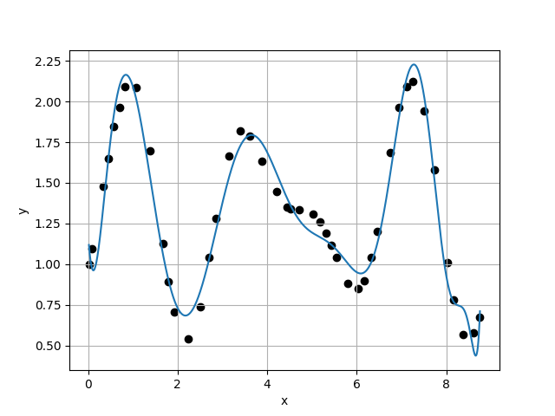
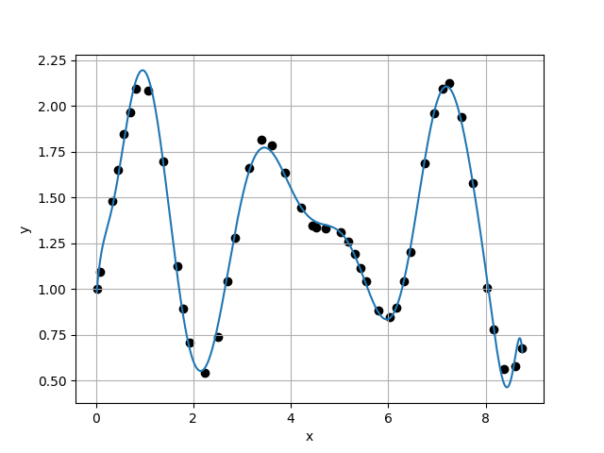
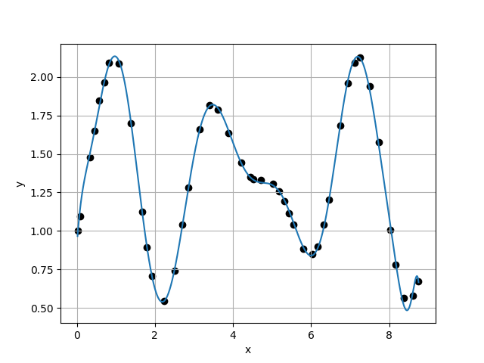
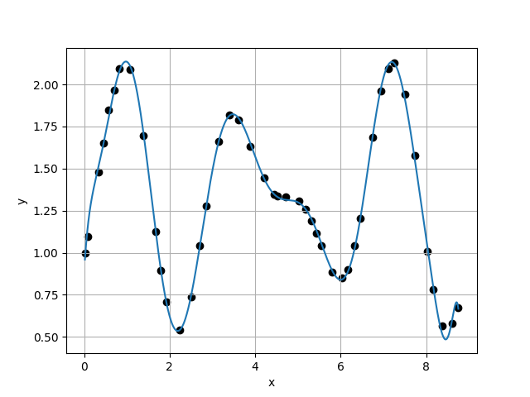
Case 21 :
Case 22 :
f(x) = 1.1971E+00 + -4.4352E+00 * x + 2.5143E+01 * x^2 + -4.1765E+01 * x^3 + 3.5107E+01 * x^4 + -1.8082E+01 * x^5 + 6.0795E+00 * x^6 + -1.2962E+00 * x^7 + 1.4852E-01 * x^8 + -2.5290E-03 * x^9 + -1.0919E-03 * x^10 + -1.1200E-05 * x^11 + 2.4294E-05 * x^12 + -2.4062E-06 * x^13 + 3.9689E-08 * x^14 + 5.3569E-08 * x^15 + -1.5099E-08 * x^16 + 1.6505E-09 * x^17 + -5.6588E-11 * x^18 + -2.1302E-12 * x^19 + 1.4161E-13 * x^20
f(x) = 9.1130E-01 + 3.9883E+00 * x + -1.7658E+01 * x^2 + 4.9207E+01 * x^3 + -6.8607E+01 * x^4 + 5.3836E+01 * x^5 + -2.6621E+01 * x^6 + 8.9204E+00 * x^7 + -2.0892E+00 * x^8 + 3.3115E-01 * x^9 + -2.9397E-02 * x^10 + -3.6985E-05 * x^11 + 2.8155E-04 * x^12 + -9.0924E-06 * x^13 + -3.4722E-06 * x^14 + 3.1329E-07 * x^15 + 1.0882E-08 * x^16 + -2.5194E-09 * x^17 + 1.6047E-10 * x^18 + -1.6530E-11 * x^19 + 1.4518E-12 * x^20 + -4.5826E-14 * x^21
1.2159E-01
4.9168E-02
2.4730E+00
1.6871E+00
Case 23 :
f(x) = 8.9555E-01 + 3.7718E+00 * x + -1.2220E+01 * x^2 + 2.7663E+01 * x^3 + -3.1421E+01 * x^4 + 1.8109E+01 * x^5 + -5.3070E+00 * x^6 + 6.0390E-01 * x^7 + 5.9007E-02 * x^8 + -2.1808E-02 * x^9 + 1.1722E-03 * x^10 + 1.3100E-04 * x^11 + -7.6800E-06 * x^12 + -8.5752E-07 * x^13 + 1.0231E-07 * x^14 + -1.6236E-08 * x^15 + -1.1984E-09 * x^16 + 3.6072E-10 * x^17 + 4.1009E-11 * x^18 + -6.4732E-12 * x^19 + -5.6029E-13 * x^20 + 1.0455E-13 * x^21 + -3.7802E-15 * x^22
Case 24 :
f(x) = 8.8130E-01 + 4.1687E+00 * x + -1.4157E+01 * x^2 + 3.1708E+01 * x^3 + -3.6081E+01 * x^4 + 2.1473E+01 * x^5 + -6.9460E+00 * x^6 + 1.1649E+00 * x^7 + -7.6380E-02 * x^8 + -2.1857E-04 * x^9 + -4.8523E-04 * x^10 + 1.5673E-05 * x^11 + 2.9020E-05 * x^12 + -1.2468E-06 * x^13 + -6.3182E-07 * x^14 + 6.3757E-08 * x^15 + -2.5137E-11 * x^16 + -8.9329E-11 * x^17 + 1.5577E-12 * x^18 + 4.2028E-13 * x^19 + -3.0868E-13 * x^20 + 1.4666E-14 * x^21 + 1.9430E-15 * x^22 + -1.2318E-16 * x^23
2.9143E-02
3.1522E-02
9.2454E-01
3.1180E-01

Slide 7
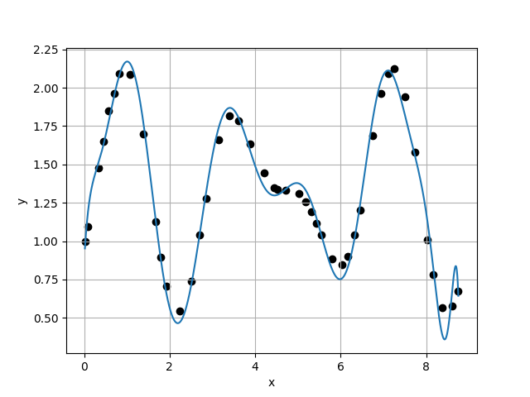
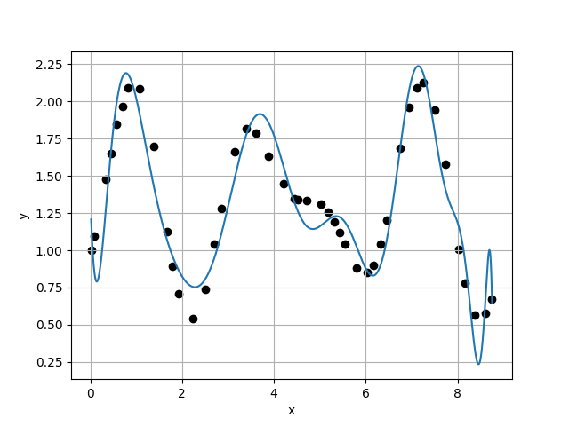
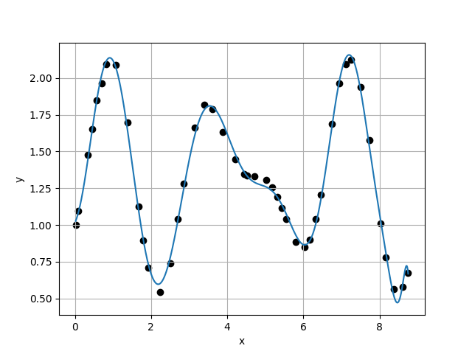
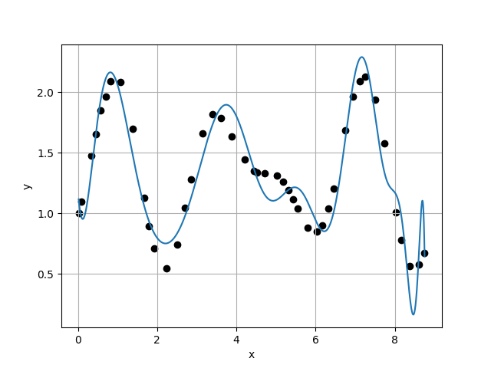
Case 25 :
Case 26 :
f(x) = 8.5895E-01 + 5.0363E+00 * x + -1.8938E+01 * x^2 + 4.2014E+01 * x^3 + -4.8118E+01 * x^4 + 3.1058E+01 * x^5 + -1.2940E+01 * x^6 + 4.0977E+00 * x^7 + -1.1019E+00 * x^8 + 2.3001E-01 * x^9 + -2.7932E-02 * x^10 + 3.7983E-04 * x^11 + 2.8818E-04 * x^12 + -8.2058E-07 * x^13 + -6.7785E-06 * x^14 + 5.0416E-07 * x^15 + 3.8156E-08 * x^16 + -3.3527E-09 * x^17 + -5.6966E-10 * x^18 + 6.1033E-11 * x^19 + 5.4968E-12 * x^20 + -1.5455E-12 * x^21 + 1.4053E-13 * x^22 + -6.2289E-15 * x^23 + 1.1101E-16 * x^24
f(x) = 1.3827E+00 + -9.7435E+00 * x + 5.0491E+01 * x^2 + -9.0205E+01 * x^3 + 8.0841E+01 * x^4 + -4.0314E+01 * x^5 + 1.0545E+01 * x^6 + -7.1548E-01 * x^7 + -3.3884E-01 * x^8 + 8.4478E-02 * x^9 + -2.3990E-03 * x^10 + -1.2888E-03 * x^11 + 1.2216E-04 * x^12 + -7.1100E-08 * x^13 + 6.8824E-07 * x^14 + -8.7698E-08 * x^15 + -1.3675E-08 * x^16 + 2.3808E-09 * x^17 + -3.0988E-10 * x^18 + 2.9268E-11 * x^19 + 1.1440E-12 * x^20 + -4.5400E-14 * x^21 + -5.1554E-14 * x^22 + 3.3932E-15 * x^23 + 1.4127E-16 * x^24 + -1.1861E-17 * x^25
1.0110E-01
2.1766E-01
4.6446E-01
4.0591E+00
Case 27 :
f(x) = 1.0147E+00 + 5.6445E-01 * x + 2.0900E+00 * x^2 + 1.9521E+00 * x^3 + -8.2328E+00 * x^4 + 6.9494E+00 * x^5 + -2.7490E+00 * x^6 + 6.0803E-01 * x^7 + -8.8290E-02 * x^8 + 1.1196E-02 * x^9 + -1.1851E-03 * x^10 + 3.3573E-05 * x^11 + 2.0308E-06 * x^12 + 1.7674E-06 * x^13 + -2.8748E-07 * x^14 + -2.9132E-10 * x^15 + 2.4480E-09 * x^16 + -2.3244E-10 * x^17 + 1.8818E-11 * x^18 + -2.4406E-12 * x^19 + 4.4033E-13 * x^20 + -3.7353E-14 * x^21 + 1.0476E-15 * x^22 + 2.3789E-17 * x^23 + -3.6582E-17 * x^24 + 5.6206E-18 * x^25 + -2.3306E-19 * x^26
Case 28 :
f(x) = 1.1953E+00 + -4.4275E+00 * x + 2.3934E+01 * x^2 + -3.4569E+01 * x^3 + 1.9460E+01 * x^4 + -1.2458E+00 * x^5 + -4.0135E+00 * x^6 + 2.1851E+00 * x^7 + -5.0269E-01 * x^8 + 4.4499E-02 * x^9 + 1.2082E-03 * x^10 + -1.2695E-05 * x^11 + -1.0498E-04 * x^12 + 7.5137E-06 * x^13 + 5.7773E-08 * x^14 + 1.5625E-07 * x^15 + -1.6533E-08 * x^16 + -3.1916E-10 * x^17 + -1.5975E-10 * x^18 + 1.4347E-11 * x^19 + 2.7873E-12 * x^20 + -8.9513E-14 * x^21 + -1.4520E-14 * x^22 + -8.7470E-16 * x^23 + 7.3877E-17 * x^24 + -1.1947E-17 * x^25 + 2.9737E-18 * x^26 + -1.5001E-19 * x^27
5.3623E-02
2.3163E-01
2.3151E-01
1.8934E+00

Slide 8
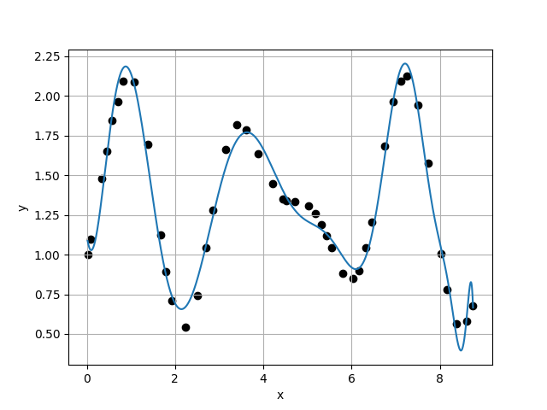
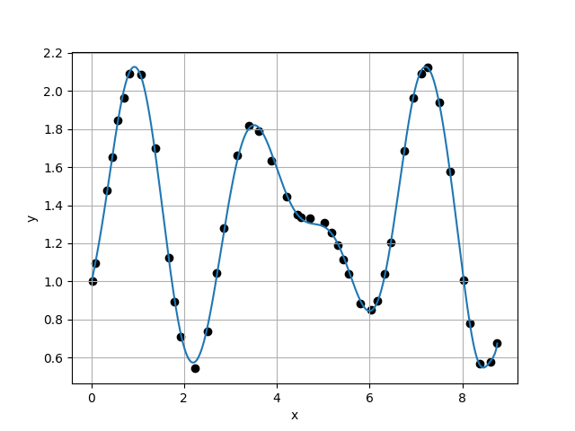
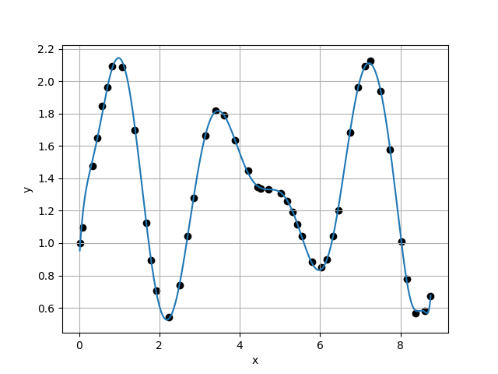
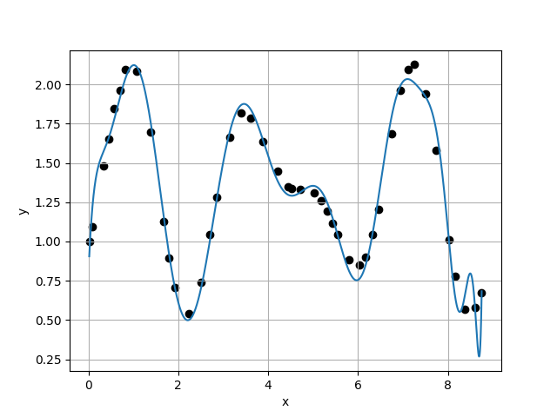
Case 29 :
Case 30 :
f(x) = 1.1211E+00 + -1.9719E+00 * x + 1.1467E+01 * x^2 + -1.0653E+01 * x^3 + -1.7922E+00 * x^4 + 7.4007E+00 * x^5 + -4.6269E+00 * x^6 + 1.3915E+00 * x^7 + -1.9586E-01 * x^8 + -1.6736E-03 * x^9 + 4.7788E-03 * x^10 + -6.0289E-04 * x^11 + 1.5608E-05 * x^12 + -1.9100E-07 * x^13 + 5.1302E-07 * x^14 + -3.7296E-08 * x^15 + -6.9538E-09 * x^16 + 8.0144E-10 * x^17 + 6.3412E-11 * x^18 + -5.0391E-12 * x^19 + -1.5020E-12 * x^20 + -1.0370E-14 * x^21 + 3.0413E-14 * x^22 + -9.9135E-16 * x^23 + 1.2092E-16 * x^24 + -5.9363E-17 * x^25 + 4.6642E-18 * x^26 + 1.0094E-20 * x^27 + -7.5858E-21 * x^28
f(x) = 9.8686E-01 + 1.2224E+00 * x + -1.6485E-01 * x^2 + 4.2569E+00 * x^3 + -7.8945E+00 * x^4 + 4.6664E+00 * x^5 + -8.8693E-01 * x^6 + -1.4447E-01 * x^7 + 8.2347E-02 * x^8 + -9.7362E-03 * x^9 + -1.5554E-04 * x^10 + 6.5347E-05 * x^11 + -8.6564E-07 * x^12 + 6.4958E-07 * x^13 + 1.1834E-08 * x^14 + -1.9437E-08 * x^15 + 2.0298E-10 * x^16 + -4.3971E-11 * x^17 + 1.4500E-11 * x^18 + 1.8577E-12 * x^19 + -3.3381E-14 * x^20 + 1.7891E-14 * x^21 + -5.7382E-15 * x^22 + -2.1468E-16 * x^23 + -1.9993E-17 * x^24 + 1.2340E-17 * x^25 + -1.3257E-19 * x^26 + -2.9356E-20 * x^27 + -5.5410E-21 * x^28 + 3.9304E-22 * x^29
1.2234E-01
2.9251E-02
4.1823E+00
8.9976E-01
Case 31 :
f(x) = 8.6998E-01 + 4.5264E+00 * x + -1.6012E+01 * x^2 + 3.5537E+01 * x^3 + -4.0051E+01 * x^4 + 2.3746E+01 * x^5 + -7.6646E+00 * x^6 + 1.2658E+00 * x^7 + -6.9863E-02 * x^8 + -4.4285E-03 * x^9 + -2.1945E-04 * x^10 + 1.1864E-04 * x^11 + 1.1636E-05 * x^12 + -2.7341E-06 * x^13 + 7.6738E-08 * x^14 + -1.3894E-08 * x^15 + 2.6998E-09 * x^16 + 5.6293E-11 * x^17 + -2.4925E-11 * x^18 + -2.1561E-12 * x^19 + 7.5843E-13 * x^20 + -1.4431E-14 * x^21 + -7.6588E-15 * x^22 + 1.0990E-16 * x^23 + 6.4306E-17 * x^24 + -4.4197E-18 * x^25 + 3.5018E-19 * x^26 + -4.9844E-20 * x^27 + 1.0610E-20 * x^28 + -1.2687E-21 * x^29 + 5.0224E-23 * x^30
Case 32 :
f(x) = 7.7901E-01 + 6.8161E+00 * x + -2.5967E+01 * x^2 + 5.4154E+01 * x^3 + -5.9609E+01 * x^4 + 3.6847E+01 * x^5 + -1.3547E+01 * x^6 + 3.0067E+00 * x^7 + -3.7546E-01 * x^8 + 1.6525E-02 * x^9 + 1.3530E-03 * x^10 + 6.8203E-05 * x^11 + -7.0000E-05 * x^12 + 5.3987E-06 * x^13 + 3.1465E-07 * x^14 + 7.0421E-09 * x^15 + -8.9447E-09 * x^16 + 6.4696E-10 * x^17 + -6.3012E-11 * x^18 + -4.9984E-12 * x^19 + 1.0551E-12 * x^20 + 2.0886E-13 * x^21 + -1.5138E-14 * x^22 + -4.2850E-16 * x^23 + -2.8592E-16 * x^24 + 2.9991E-17 * x^25 + -3.5514E-18 * x^26 + 6.1690E-19 * x^27 + -3.6717E-20 * x^28 + 5.6647E-21 * x^29 + -8.8978E-22 * x^30 + 3.9103E-23 * x^31
3.2510E-02
1.1599E-01
2.8028E-01
1.2240E+00

Slide 9
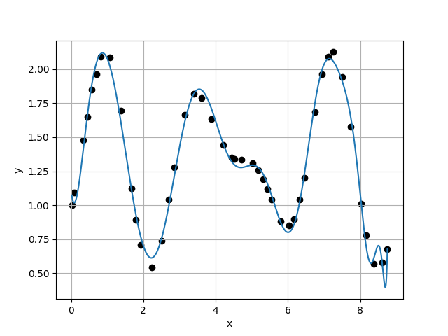
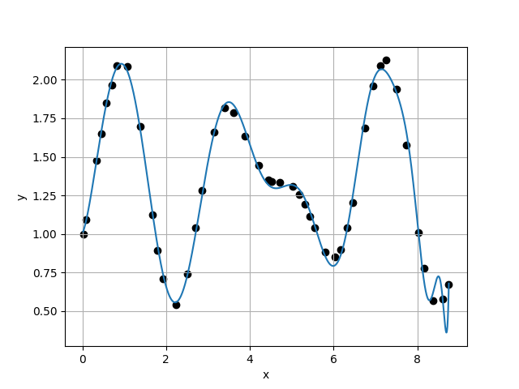
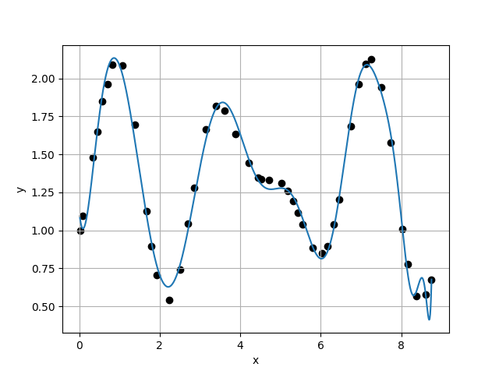
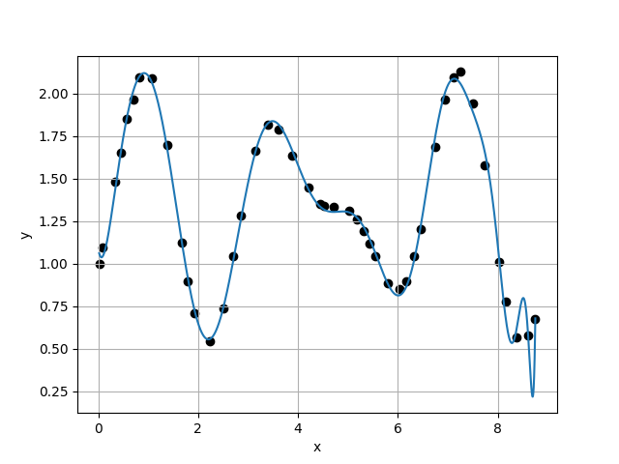
Case 33 :
Case 34 :
f(x) = 1.1150E+00 + -2.4261E+00 * x + 1.7562E+01 * x^2 + -3.1199E+01 * x^3 + 2.8926E+01 * x^4 + -1.7237E+01 * x^5 + 6.7976E+00 * x^6 + -1.6745E+00 * x^7 + 2.2770E-01 * x^8 + -1.3076E-02 * x^9 + 6.3171E-04 * x^10 + -2.3359E-04 * x^11 + 1.6883E-05 * x^12 + 2.5103E-06 * x^13 + -3.0288E-07 * x^14 + 2.6992E-08 * x^15 + -1.4340E-09 * x^16 + -4.0691E-10 * x^17 + -2.3615E-11 * x^18 + 7.2606E-12 * x^19 + 1.2979E-13 * x^20 + 7.1111E-14 * x^21 + -8.2786E-15 * x^22 + -6.2746E-16 * x^23 + 6.4065E-17 * x^24 + -1.4001E-17 * x^25 + 1.1509E-18 * x^26 + -6.6065E-20 * x^27 + 1.5215E-20 * x^28 + 9.8744E-22 * x^29 + -1.3711E-22 * x^30 + -1.8738E-23 * x^31 + 1.4823E-24 * x^32
f(x) = 1.0018E+00 + 5.9743E-01 * x + 4.3179E+00 * x^2 + -8.1364E+00 * x^3 + 9.2735E+00 * x^4 + -8.8575E+00 * x^5 + 5.5480E+00 * x^6 + -2.0212E+00 * x^7 + 4.0777E-01 * x^8 + -4.1258E-02 * x^9 + 2.2029E-03 * x^10 + -3.7136E-04 * x^11 + 5.0689E-05 * x^12 + 3.9898E-06 * x^13 + -7.8103E-07 * x^14 + -7.8128E-08 * x^15 + 9.4272E-09 * x^16 + 8.7514E-10 * x^17 + -4.4065E-11 * x^18 + 3.6843E-12 * x^19 + -2.5128E-12 * x^20 + -1.0013E-13 * x^21 + 5.1885E-14 * x^22 + 8.4173E-16 * x^23 + -4.4949E-16 * x^24 + 5.2904E-18 * x^25 + -5.8806E-19 * x^26 + 4.2728E-20 * x^27 + -1.4355E-20 * x^28 + 6.3772E-21 * x^29 + -2.8760E-22 * x^30 + -1.8565E-23 * x^31 + -5.8031E-25 * x^32 + 1.2047E-25 * x^33
9.4764E-02
7.3789E-02
1.2843E+00
6.8298E-01
Case 35 :
f(x) = 1.1289E+00 + -2.6808E+00 * x + 1.7870E+01 * x^2 + -2.9664E+01 * x^3 + 2.4668E+01 * x^4 + -1.2655E+01 * x^5 + 4.1313E+00 * x^6 + -7.5891E-01 * x^7 + 4.0411E-02 * x^8 + 8.7694E-03 * x^9 + -8.4147E-04 * x^10 + -9.8810E-05 * x^11 + -1.5852E-06 * x^12 + 2.5222E-06 * x^13 + -3.7511E-08 * x^14 + 1.0472E-08 * x^15 + -2.3075E-09 * x^16 + -2.7903E-10 * x^17 + -1.5519E-11 * x^18 + 3.6992E-12 * x^19 + 3.9737E-13 * x^20 + 4.7933E-14 * x^21 + -1.2801E-15 * x^22 + -1.3045E-15 * x^23 + 3.0196E-17 * x^24 + -3.7666E-18 * x^25 + 3.8688E-19 * x^26 + 9.7547E-20 * x^27 + -8.3495E-21 * x^28 + 8.4201E-22 * x^29 + -6.8793E-23 * x^30 + 2.2952E-24 * x^31 + 1.8017E-25 * x^32 + -1.1140E-25 * x^33 + 7.4636E-27 * x^34
Case 36 :
f(x) = 1.0880E+00 + -1.6711E+00 * x + 1.5691E+01 * x^2 + -3.3990E+01 * x^3 + 4.3027E+01 * x^4 + -3.6797E+01 * x^5 + 2.0858E+01 * x^6 + -7.6419E+00 * x^7 + 1.7696E+00 * x^8 + -2.4670E-01 * x^9 + 1.8231E-02 * x^10 + -4.5647E-04 * x^11 + -1.0375E-05 * x^12 + 1.1818E-06 * x^13 + -8.5945E-08 * x^14 + 5.2644E-09 * x^15 + -9.3471E-09 * x^16 + 3.7129E-10 * x^17 + 1.1614E-10 * x^18 + 2.0374E-11 * x^19 + -2.0673E-12 * x^20 + -2.1859E-13 * x^21 + -3.4259E-14 * x^22 + 2.7188E-15 * x^23 + 6.6643E-16 * x^24 + -4.6442E-17 * x^25 + 1.4144E-17 * x^26 + -1.3721E-18 * x^27 + -1.6914E-19 * x^28 + 5.9911E-21 * x^29 + 2.2320E-21 * x^30 + -8.0209E-23 * x^31 + 1.4869E-25 * x^32 + -2.0208E-25 * x^33 + -7.1226E-26 * x^34 + 5.4430E-27 * x^35
1.0804E-01
8.2947E-02
1.3025E+00
6.4069E-01

Slide 10
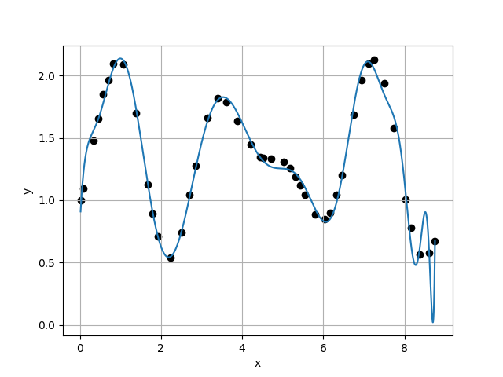
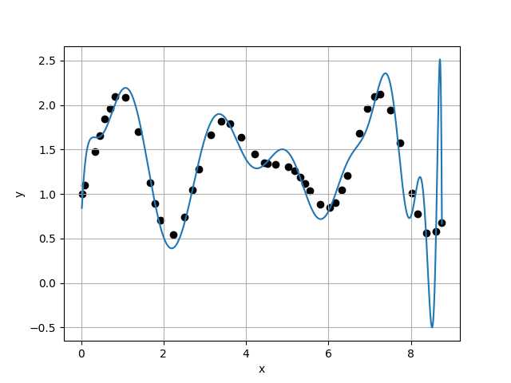
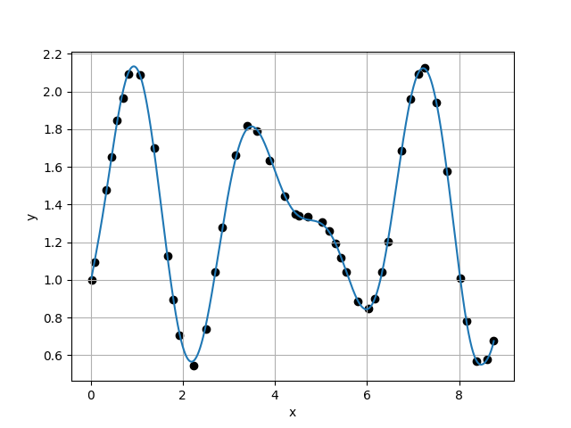
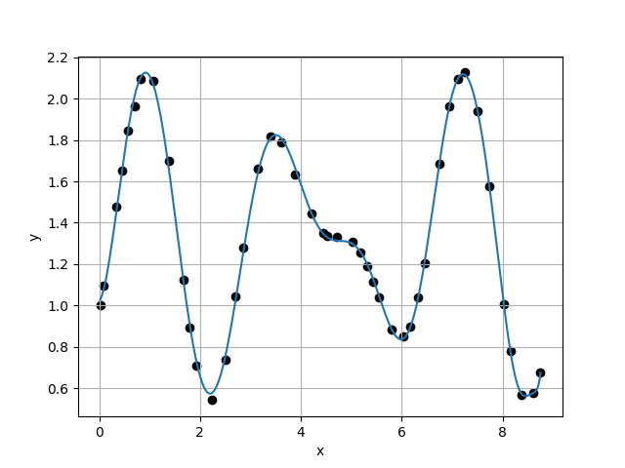
Case 37 :
Case 38 :
f(x) = 7.8155E-01 + 6.9313E+00 * x + -2.7614E+01 * x^2 + 5.9551E+01 * x^3 + -6.6867E+01 * x^4 + 4.1305E+01 * x^5 + -1.4420E+01 * x^6 + 2.6126E+00 * x^7 + -1.0576E-01 * x^8 + -4.5384E-02 * x^9 + 6.9607E-03 * x^10 + -3.7898E-05 * x^11 + -1.4790E-05 * x^12 + -1.2580E-05 * x^13 + 2.1683E-06 * x^14 + -9.0685E-08 * x^15 + -1.0383E-08 * x^16 + 2.0053E-09 * x^17 + -1.9392E-10 * x^18 + 1.9824E-11 * x^19 + -8.2295E-13 * x^20 + 3.7054E-15 * x^21 + -4.6301E-14 * x^22 + 3.8636E-15 * x^23 + 1.8921E-16 * x^24 + 3.6509E-17 * x^25 + -5.3343E-18 * x^26 + 4.0796E-19 * x^27 + -8.3062E-20 * x^28 + -2.2851E-21 * x^29 + 6.4259E-22 * x^30 + -5.3411E-23 * x^31 + 1.4956E-23 * x^32 + -1.0103E-25 * x^33 + -9.6169E-26 * x^34 + -4.7735E-27 * x^35 + 6.1073E-28 * x^36
f(x) = 6.4564E-01 + 1.0713E+01 * x + -4.4221E+01 * x^2 + 8.8224E+01 * x^3 + -9.1732E+01 * x^4 + 5.3955E+01 * x^5 + -1.9105E+01 * x^6 + 4.2648E+00 * x^7 + -6.3558E-01 * x^8 + 6.9513E-02 * x^9 + -5.9315E-03 * x^10 + 3.8182E-04 * x^11 + -2.5704E-05 * x^12 + -1.0513E-07 * x^13 + 5.9766E-07 * x^14 + 8.3525E-09 * x^15 + -1.9097E-08 * x^16 + 2.2641E-09 * x^17 + -8.0852E-11 * x^18 + -1.3391E-11 * x^19 + 3.4085E-13 * x^20 + -1.4006E-13 * x^21 + 8.3393E-14 * x^22 + -1.7484E-15 * x^23 + -5.0681E-16 * x^24 + 2.5118E-17 * x^25 + -7.0679E-18 * x^26 + -1.3170E-18 * x^27 + 1.4271E-19 * x^28 + 9.8764E-21 * x^29 + 1.4249E-21 * x^30 + 4.0120E-23 * x^31 + -1.7920E-23 * x^32 + -2.3205E-24 * x^33 + -2.6427E-25 * x^34 + 3.9485E-26 * x^35 + 3.5574E-27 * x^36 + -3.1432E-28 * x^37
1.2946E-01
3.4293E-01
3.7752E-01
1.0568E+01
Case 39 :
f(x) = 9.8283E-01 + 1.3903E+00 * x + -1.1633E+00 * x^2 + 6.4816E+00 * x^3 + -1.0349E+01 * x^4 + 6.2451E+00 * x^5 + -1.5746E+00 * x^6 + 9.4847E-02 * x^7 + 1.0941E-02 * x^8 + 6.3885E-03 * x^9 + -2.3599E-03 * x^10 + 1.9007E-04 * x^11 + -2.9508E-06 * x^12 + 2.8688E-06 * x^13 + -4.2368E-07 * x^14 + 6.4815E-09 * x^15 + -1.7260E-09 * x^16 + 2.3934E-10 * x^17 + 2.1740E-11 * x^18 + -2.1495E-12 * x^19 + 3.6554E-13 * x^20 + -5.4080E-15 * x^21 + -6.6295E-15 * x^22 + -4.2881E-16 * x^23 + 2.6865E-17 * x^24 + 1.0049E-17 * x^25 + 4.2485E-19 * x^26 + 6.4083E-21 * x^27 + -2.1099E-20 * x^28 + 7.4019E-22 * x^29 + -6.9013E-23 * x^30 + 1.7572E-23 * x^31 + 1.3093E-24 * x^32 + -2.9846E-25 * x^33 + 5.3821E-27 * x^34 + -4.1577E-28 * x^35 + 2.0690E-28 * x^36 + -1.4521E-29 * x^37 + 2.6073E-31 * x^38
Case 40 :
f(x) = 1.0203E+00 + 2.8974E-01 * x + 4.4080E+00 * x^2 + -5.1497E+00 * x^3 + 2.2843E+00 * x^4 + -1.6475E+00 * x^5 + 1.3628E+00 * x^6 + -5.4622E-01 * x^7 + 8.9768E-02 * x^8 + -1.3853E-03 * x^9 + -5.4740E-04 * x^10 + -1.5174E-04 * x^11 + 1.6786E-05 * x^12 + 3.3136E-06 * x^13 + -1.4050E-07 * x^14 + -4.8510E-08 * x^15 + 5.2152E-10 * x^16 + -1.3732E-10 * x^17 + 4.9782E-11 * x^18 + 4.7184E-12 * x^19 + 1.6039E-13 * x^20 + -4.3100E-14 * x^21 + -1.3465E-14 * x^22 + -6.6716E-16 * x^23 + 2.0000E-16 * x^24 + 9.9297E-18 * x^25 + -4.8023E-20 * x^26 + -2.0435E-19 * x^27 + 9.1803E-23 * x^28 + -2.7675E-22 * x^29 + 2.7466E-22 * x^30 + -1.1759E-23 * x^31 + 1.2585E-24 * x^32 + -6.0760E-25 * x^33 + 4.5197E-26 * x^34 + 6.2002E-28 * x^35 + 2.1840E-29 * x^36 + -4.9269E-30 * x^37 + -1.4794E-30 * x^38 + 9.2645E-32 * x^39
3.2449E-02
5.1073E-02
6.3533E-01
9.4716E-01

Slide 11
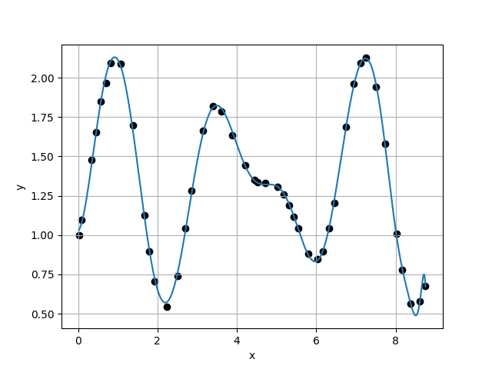
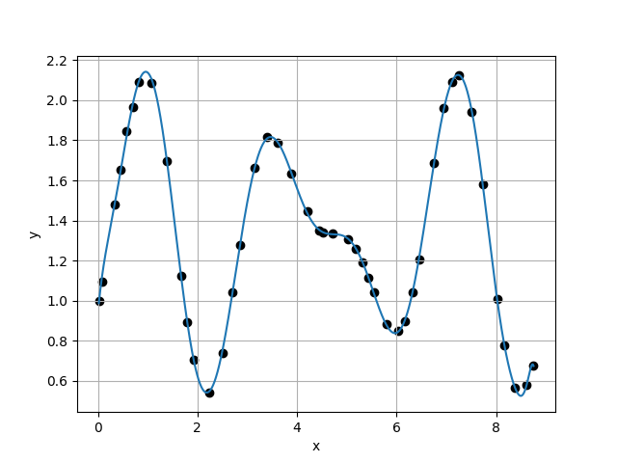
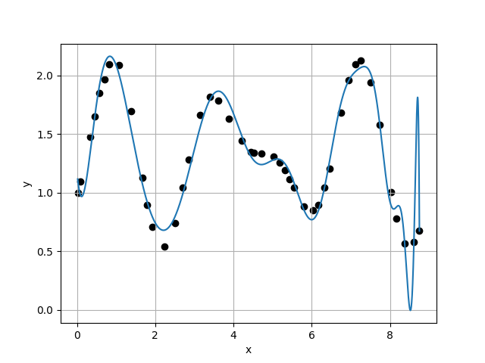
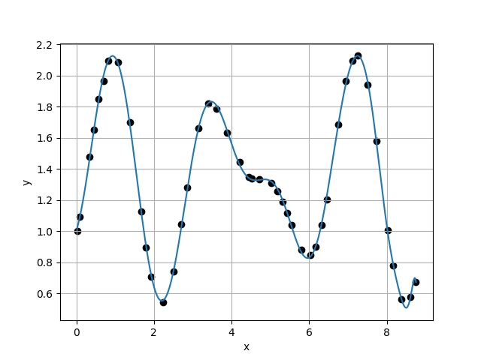
Case 41 :
Case 42 :
f(x) = 1.0249E+00 + 2.1445E-01 * x + 4.5613E+00 * x^2 + -5.1253E+00 * x^3 + 1.9864E+00 * x^4 + -1.3184E+00 * x^5 + 1.1810E+00 * x^6 + -4.8615E-01 * x^7 + 7.7306E-02 * x^8 + 1.0903E-04 * x^9 + -4.7282E-04 * x^10 + -2.7207E-04 * x^11 + 5.4393E-05 * x^12 + -1.6407E-06 * x^13 + -1.2694E-07 * x^14 + 4.1298E-09 * x^15 + -1.6152E-09 * x^16 + -7.3512E-11 * x^17 + 1.0657E-11 * x^18 + 2.0780E-12 * x^19 + 4.4051E-13 * x^20 + -5.3985E-14 * x^21 + 2.6131E-15 * x^22 + 2.1449E-16 * x^23 + -1.3057E-16 * x^24 + -3.0694E-18 * x^25 + 5.2980E-19 * x^26 + 1.1599E-19 * x^27 + 1.2184E-20 * x^28 + -1.5046E-21 * x^29 + -2.6165E-22 * x^30 + 5.7248E-23 * x^31 + -4.1891E-24 * x^32 + -6.9021E-26 * x^33 + 4.7443E-26 * x^34 + -8.5961E-27 * x^35 + 4.7823E-28 * x^36 + 2.7315E-29 * x^37 + 6.6620E-31 * x^38 + -4.7103E-31 * x^39 + 1.8893E-32 * x^40
f(x) = 9.3634E-01 + 2.7379E+00 * x + -7.7185E+00 * x^2 + 1.9542E+01 * x^3 + -2.3862E+01 * x^4 + 1.4297E+01 * x^5 + -4.4234E+00 * x^6 + 6.5978E-01 * x^7 + -3.0069E-02 * x^8 + -2.6079E-04 * x^9 + -5.8379E-04 * x^10 + 4.8493E-05 * x^11 + 3.5811E-06 * x^12 + 9.9878E-07 * x^13 + -6.9396E-08 * x^14 + -2.6022E-08 * x^15 + 1.2430E-09 * x^16 + 2.4504E-11 * x^17 + 3.7801E-12 * x^18 + 2.1140E-12 * x^19 + 7.0036E-14 * x^20 + -3.4374E-14 * x^21 + 2.6726E-15 * x^22 + -6.0649E-16 * x^23 + 5.2213E-17 * x^24 + -2.1310E-18 * x^25 + -8.5129E-19 * x^26 + 1.3883E-19 * x^27 + -2.6414E-21 * x^28 + 5.8407E-22 * x^29 + 7.1923E-24 * x^30 + -1.3795E-23 * x^31 + 3.0054E-26 * x^32 + 7.8767E-26 * x^33 + 7.1766E-27 * x^34 + -2.5583E-27 * x^35 + -7.5589E-29 * x^36 + 2.2149E-29 * x^37 + 4.0908E-30 * x^38 + -3.0846E-31 * x^39 + -3.0021E-32 * x^40 + 2.1188E-33 * x^41
5.3922E-02
3.4832E-02
1.5481E+00
9.5491E-02
Case 43 :
f(x) = 1.1904E+00 + -4.1297E+00 * x + 2.2690E+01 * x^2 + -3.3746E+01 * x^3 + 2.1527E+01 * x^4 + -4.8861E+00 * x^5 + -1.6159E+00 * x^6 + 1.4036E+00 * x^7 + -3.8929E-01 * x^8 + 4.6298E-02 * x^9 + -1.3536E-03 * x^10 + 1.5004E-04 * x^11 + -7.3624E-05 * x^12 + 1.3330E-06 * x^13 + 1.1132E-06 * x^14 + -3.5612E-08 * x^15 + -6.1782E-09 * x^16 + 4.8725E-10 * x^17 + -1.1283E-11 * x^18 + -5.9512E-12 * x^19 + -1.2240E-12 * x^20 + 1.3811E-13 * x^21 + 8.1359E-15 * x^22 + -3.9396E-16 * x^23 + 3.0976E-16 * x^24 + 8.0172E-18 * x^25 + -1.5955E-18 * x^26 + -6.4323E-19 * x^27 + -4.2284E-20 * x^28 + 1.3947E-21 * x^29 + 4.3362E-22 * x^30 + 5.0434E-23 * x^31 + 9.9883E-24 * x^32 + -6.4015E-25 * x^33 + -3.8379E-26 * x^34 + 5.5776E-27 * x^35 + -9.1462E-28 * x^36 + -1.5709E-28 * x^37 + 6.0630E-30 * x^38 + 6.1531E-31 * x^39 + 9.1490E-32 * x^40 + 8.5038E-33 * x^41 + -1.2899E-33 * x^42
Case 44 :
f(x) = 1.0025E+00 + 8.0662E-01 * x + 2.1051E+00 * x^2 + -1.1534E+00 * x^3 + -1.1536E+00 * x^4 + 2.7035E-02 * x^5 + 8.1176E-01 * x^6 + -3.7589E-01 * x^7 + 3.5722E-02 * x^8 + 1.0810E-02 * x^9 + -1.8113E-03 * x^10 + -1.9503E-04 * x^11 + 3.5992E-05 * x^12 + 2.8264E-06 * x^13 + -2.5909E-07 * x^14 + -4.5244E-08 * x^15 + 3.5906E-10 * x^16 + 5.9811E-11 * x^17 + 3.6551E-11 * x^18 + 4.6298E-12 * x^19 + -5.0649E-13 * x^20 + 8.4206E-15 * x^21 + -4.2376E-15 * x^22 + 6.3999E-16 * x^23 + -1.2676E-16 * x^24 + 4.4708E-18 * x^25 + 4.6126E-19 * x^26 + 2.9748E-20 * x^27 + -5.1038E-21 * x^28 + -1.3848E-22 * x^29 + 9.4719E-23 * x^30 + 5.2496E-25 * x^31 + 1.5643E-24 * x^32 + -2.5611E-25 * x^33 + 2.0777E-27 * x^34 + -1.7631E-27 * x^35 + -1.8535E-28 * x^36 + 1.6114E-29 * x^37 + 5.2222E-30 * x^38 + -1.3416E-31 * x^39 + 2.0964E-32 * x^40 + -3.7660E-33 * x^41 + -3.5030E-34 * x^42 + 3.4112E-35 * x^43
3.6477E-01
7.8316E-02
4.6577E+00

